Slide 1
CYBR 520
Module 3: Introduction to Machine Learning and Security
Chapter 1:Introduction to machine learning with Python: a guide for data scientists**
Chapter 1: Machine learning and security- Protecting systems with data and algorithms***

Slide 2
Please refer to Module 3 on github to obtain the codes or refer to the book’s github repo

Slide 3
Table of contents
Machine Learning Introduction
Why Machine Learning and Security?
The Cyber Threat Taxonomy
The Cyber Attacker’s Economy
Uses of Machine Learning

Slide 4
What is the minimum No. of lines needed to connect the dots?
# Dots | # lines
2 | 1
3 | 3
4 | 6
5 | 10
….
…
…… 900?
A
*
B
*
*
C
*
D
*
E
Expressing the relationship between dots and lines

Slide 5
Which of these do not belong?
X T O Z P W L N C
4 1 0 3 2 3 1 2 6

Slide 6
Introduction
Machine learning is an interdisciplinary research field that combines statistics, artificial intelligence, and computer science.
It is also referred to as predictive analytics or statistical learning.
Machine learning techniques are widely used in various applications, including personalized recommendations, image recognition, and complex website functionality like Facebook or Amazon.
These applications often incorporate multiple machine learning models.

Slide 7
Introduction
Beyond commercial use, machine learning has transformed data-driven research in areas such as astrophysics, genetics, and healthcare.
This chapter will outline the reasons behind machine learning's popularity, the types of problems it can address, and provide an introduction to building machine learning models.

Slide 8
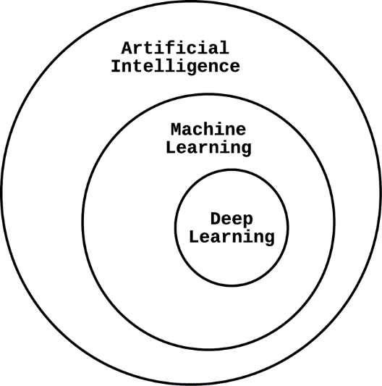
What is Machine Learning?
Machine learning is a type of computer technology that enables computers to learn and make decisions from data without being explicitly programmed.

Slide 9
Traditional Programming vs. Machine Learning
Traditional Programming: Code tells the computer what to do.
Machine Learning: Computer learns from data and makes decisions.

Slide 10
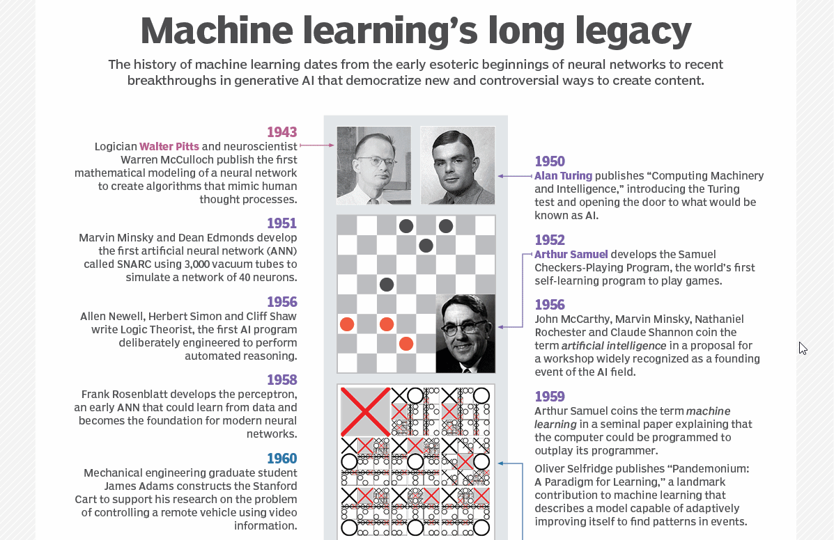
Source: https://www.techtarget.com/searchenterpriseai/definition/machine-learning-ML

Slide 11
What is Machine Learning?
It is feeding data to an algorithm (Machine Learning Algorithm):
to gradually improve outcomes with experience.
train it on how to achieve a certain outcome.
Classification
Prediction

Slide 12
Classification
In classification, an algorithm is fed data in hope to teach it to :
tell whether an image is of a cat or not
Does this patient have cancer?

Slide 13
Prediction
In classification, an algorithm is fed data in hope to teach it to :
Will this stock go up?
What should you read next?

Slide 14
How Does Machine Learning Work?
Data Collection: Gather a large amount of data related to a problem.
Training: Teach the computer by showing it examples from the data.
Prediction: The computer makes predictions or decisions based on what it has learned.

Slide 15
Data Collection
Raw data is everywhere.
Transformation and cleaning is needed
Features needs to be extracted
Features might also be engineered

Slide 16
Data Collection
If you want to design a ML model that classify whether a car is SVU, Sedan, Truck:
What would you collect?
How do you know that?

Slide 17
Applications of Machine Learning
Examples: Recommendations (Netflix, Amazon), Image Recognition (Facebook tagging), Speech Recognition (Siri), Medical Diagnosis, Self-Driving Cars.

Slide 18
Benefits of Machine Learning
Automation: Automate repetitive tasks.
Personalization: Customize recommendations and user experiences.
Accuracy: Make predictions with high accuracy.
Scalability: Handle large datasets and complex problems.

Slide 19
Challenges and Considerations
Data Quality: Machine learning relies on good quality data.
Bias: Models can inherit biases from the data.
Interpretability: Understanding how the model makes decisions can be challenging.

Slide 20
Getting Started with Machine Learning
Learn: Online courses, books, tutorials.
Tools: Python, libraries like TensorFlow or scikit-learn.
Practice: Work on simple projects.

Slide 21
Types of Machine Learning
Supervised Learning: Computer learns from labeled examples (e.g., predicting house prices).
Unsupervised Learning: Computer finds patterns in data without labels (e.g., clustering similar customer groups).
Reinforcement Learning: Computer learns through trial and error (e.g., training a game-playing AI).

Slide 22
Supervised Machine Learning***
At the most general level, supervised machine learning methods adopt a Bayesian approach to knowledge discovery, using probabilities of previously observed events to infer the probabilities of new events.
Datasets have labels (spam, cancer, buggy file etc..)

Slide 23
Supervised Machine Learning***
Suppose that we want to classify a group of animals into mammals and reptiles.
With a supervised method, we will have a set of animals for which we are definitively told their category (e.g., we are told that the dog and elephant are mammals and the alligator and iguana are reptiles).
We then try to extract some features from each of these labeled data points and find similarities in their properties, allowing us to differentiate animals of different classes.

Slide 24
Supervised Machine Learning***
For instance, we see that the dog and the elephant both give birth to live offspring, unlike the alligator and the iguana.
The binary property “gives birth to live offspring” is what we call a feature, a useful abstraction for observed properties that allows us to perform comparisons between different observations.
After extracting a set of features that might help differentiate mammals and reptiles in the labeled data, we then can run a learning algorithm on the labeled data and apply what the algorithm learned to new, unseen animals.

Slide 25
Supervised Machine Learning***
When the algorithm is presented with a meerkat, it now must classify it as either a mammal or a reptile.
Extracting the set of features from this new animal, the algorithm knows that the meerkat does not lay eggs, has no scales, and is warm-blooded.
Driven by prior observations, it makes a category prediction that the meerkat is a mammal, and it is exactly right.

Slide 26
Unsupervised Machine Learning
Unsupervised methods draw abstractions from unlabeled datasets and apply these to new data.
Clustering
Datasets have no labels, only features

Slide 27
Unsupervised Machine Learning***
In the unsupervised case, the premise is similar, but the algorithm is not presented with the initial set of labeled animals.
Instead, the algorithm must group the different sets of data points in a way that will result in a binary classification.

Slide 28
Unsupervised Machine Learning***
Seeing that most animals that don’t have scales do give birth to live offspring and are also warm-blooded, and most animals that have scales lay eggs and are cold-blooded, the algorithm can then derive the two categories from the provided set and make future predictions in the same way as in the supervised case.

Slide 29
Why Machine Learning and Security?
In the early days of the internet, the primary nuisance was spam.
Let's explore email spam as a real-world example of how machine learning is applied to security challenges.
Today, modern spam filters block more than 99.9% of spam, an impressive improvement from early filtering techniques.

Slide 30
Why Machine Learning and Security?
Machine learning plays a crucial role in addressing evolving cybersecurity threats. It's a powerful tool adopted by security experts.
Machine learning is integrated into email spam filters.
These filters use content-based models and user behavior feedback loops to distinguish spam from legitimate emails.

Slide 31
Why Machine Learning and Security?
The battle against spam teaches us the importance of using data to enhance our security measures.
In cybersecurity, attackers and defenders are in a continuous struggle to exploit or protect against vulnerabilities.

Slide 32
Why Machine Learning and Security?
With powerful data analysis and machine learning tools, there are vast opportunities to improve security across various domains.

Slide 33
Why Machine Learning and Security?
Bottom line, if you are collecting data you truly need to understand that problem you are dealing with.
The landscape of cybersecurity attacks is massive.

Slide 34
Cyber Threat Landscape
The landscape of adversaries and miscreants in computer security has evolved over time, but the general categories of threats have remained the same.
Security research exists to stymie the goals of attackers, and it is always important to have a good understanding of the different types of attacks that exist in the wild.

Slide 35
Cyber Threat Landscape
In this book (***), we will be using The taxonomy given in the next slide.
Please get familiar with these concepts.

Slide 36
Cyber Threat Taxonomy
Malware
Worm
Trojan
Spyware
Adware
Ransomware
Rootkit
Backdoor
Bot
Botnet
Exploit
Scanning
Sniffing
Keylogger
Login attack
Account takeover (ATO)
Phishing
Spear Phishing
Social engineering
Incendiary speech
Denial of service
Advanced persistent threats (APTs)

Slide 37
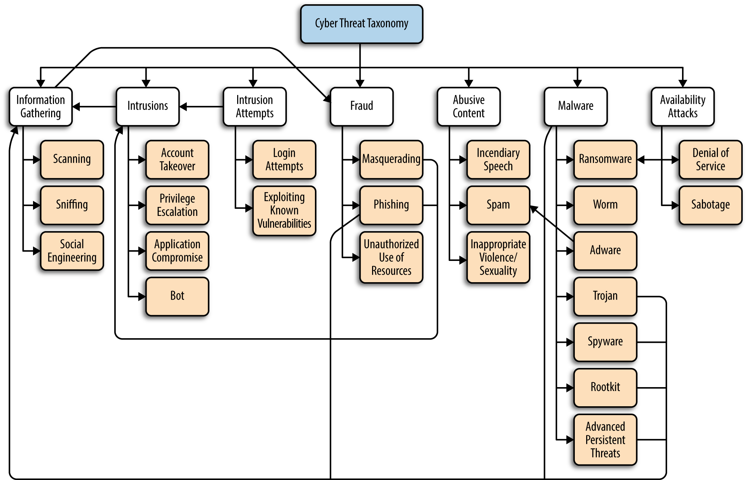
Cyber Threat Landscape

Slide 38
The Cyber Attacker’s Economy
Cyber attackers are primarily motivated by financial gain today.
In the early days of the internet, some hackers sought online reputation or engaged in mischief.
However, the landscape has shifted towards a cash-driven economy, with attackers targeting financial institutions for direct monetary benefits.

Slide 39
The Cyber Attacker’s Economy
These institutions, though, have strong defenses, resulting in a competitive marketplace for vulnerabilities. As a result, attackers often focus on entities with weaker security, exploiting open systems and indirect techniques for monetization.

Slide 40
A Marketplace for Hacking Skills
Darknet marketplaces and illegal hacking forums are well-known in the cybersecurity landscape. In the past, only highly skilled hackers could engage in cyber attacks and compromise computer systems.
However, the landscape has changed significantly.
Hacking tools and resources have become commoditized and readily accessible, allowing less skilled individuals, often referred to as "script-kiddies," to participate in cyber attacks.

Slide 41
A Marketplace for Hacking Skills
The market for zero-day vulnerabilities, which are previously unknown software flaws, exists both legally and illegally. It has become a source of income for security researchers and hackers alike.
Surprisingly, the most skilled hackers no longer launch attacks themselves; the risks are high, and the process of turning vulnerabilities into money is uncertain.
Instead, they create user-friendly hacking tools, sell vulnerabilities on marketplaces, and sometimes even offer hacking consulting services. This approach offers a more direct and certain path to financial gain.

Slide 42
Indirect Monetization
The monetization process for individuals involved in various computer attacks is quite diverse and merits detailed examination.
While we won't delve too deeply into the specifics, let's explore a couple of examples of how indirect monetization can function.
Malware Distribution
Spyware and Data Theft

Slide 43
Malware Distribution
The distribution of malware has evolved, much like the growth of cloud computing and Infrastructure-as-a-Service (IaaS) providers.
Malware authors and purchasers utilize the pay-per-install (PPI) marketplace, offering a complex ecosystem for propagating malware widely.
Additionally, botnet rentals resemble on-demand cloud services, providing competitive pricing for per-hour resources.
Deploying malware on remote servers can also be financially rewarding. Targeted attacks may come with a bounty, and ransomware is an efficient way to extort money from numerous victims.

Slide 44
Spyware and Data Theft
Spyware can assist in stealing private information, which can then be sold in bulk on online marketplaces.
Adware and spam are used as low-cost methods to advertise questionable pharmaceuticals and financial products.
Online accounts are frequently hijacked to access stored value, such as gift cards, loyalty points, or store credit.
Stolen information like credit card numbers, Social Security numbers, email accounts, and more can be sold online for identity theft, fake account creation, fraud, and related activities.
However, monetization, especially with stolen credit card numbers, can be complex.
Credit card companies and account providers often implement measures to prevent attackers from cashing in, like invalidating compromised accounts or adding extra authentication steps for gift card redemptions.

Slide 45
Adversaries Using Machine Learning
Adversaries have the ability to leverage machine learning techniques to avoid detection and outsmart defense systems.
Just as defenders can learn from cyber attacks and adjust their security measures, attackers can also gain insights into defense mechanisms to their advantage.

Slide 46
Polymorphic Payloads
Spammers, for example, use polymorphism, which means they change the appearance of their malicious content while keeping its meaning intact. This helps them slip past detection systems. They might also test different email content variations (A/B tests) to see what tricks spam filters or entices recipients to click.

Slide 47
Fuzzing Campaigns
Both attackers and defenders employ machine learning in fuzzing campaigns, which are used to discover software vulnerabilities more quickly. Attackers use these techniques to find weaknesses

Slide 48
Crafting Targeted Phishing
Attackers can use machine learning to analyze your online behavior and interests, often through social media, to create highly personalized phishing messages that are more likely to fool you.

Slide 49
Adversarial Machine Learning
In a field known as adversarial machine learning, attackers manipulate machine learning systems.
They can make algorithms produce incorrect predictions or learn the wrong things, especially when the machine learning model's decision-making process is not transparent or explainable.

Slide 50
Keep in mind
Machine learning algorithms are often not built with security as a primary consideration, which leaves them vulnerable to attacks by determined adversaries.
Therefore, it's crucial to be aware of these potential threat models when developing machine learning systems for security purposes.

Slide 51
Real-World Uses of Machine Learning in Security
In this book, various real-world applications of machine learning in security are explored. Implementing machine learning and data science to address security challenges is not straightforward.
Developers encounter numerous decisions during the process, despite the availability of convenient programming libraries.

Slide 52
Real-World Uses of Machine Learning in Security
The applications covered here are not new, and you can find the data science techniques discussed at the heart of many computer systems used daily.
Machine learning's applications in security can be broadly categorized into two categories: pattern recognition and anomaly detection.

Slide 53
Real-World Uses of Machine Learning in Security
While the line between these categories can blur, each has distinct objectives.
Pattern Recognition
Anomaly Detection

Slide 54
Pattern Recognition:
In pattern recognition, the goal is to identify specific or latent characteristics within data.
These characteristics are distilled into feature sets that train algorithms to recognize similar data patterns.
For instance, spam detection seeks explicit features characterizing spam emails.

Slide 55
Anomaly Detection
Anomaly detection, on the other hand, aims to establish what is considered "normal" within a dataset (e.g., 95% of data) and subsequently identifies deviations from this norm as anomalies.

Slide 56
Pay attention
It's crucial to differentiate anomaly detection from merely recognizing a set of normal patterns and distinguishing them from abnormal ones.
Pattern recognition extracts patterns strictly from observed data, while anomaly detection can detect an infinite number of anomalous patterns, even those that don't exist in the training or testing datasets.

Slide 57
Uses of ML
Examples include spam detection, which can be seen as both pattern recognition and anomaly detection, and malware detection and botnet detection, which fall under pattern recognition.

Slide 58
Uses of ML
Machine learning is also employed in fuzzing, a process used to test software vulnerabilities.
For user authentication and behavior analysis, the distinction between pattern recognition and anomaly detection can become less clear, often requiring a combination of both approaches.
Network outlier detection is a classic case of anomaly detection, while access control systems benefit from machine learning's adaptability.

Slide 59
Uses of ML
Machine learning addresses access control challenges by inferring information access patterns and responding when unconventional patterns are detected.
This approach offers more flexibility than rigid rule-based systems.
For instance, in a hospital's patient record storage system, machine learning can allow different access patterns for nurses and doctors based on their unique requirements.

Slide 60
Spam Fighting: An Iterative Approach
You will not really need to run the Spam Filtering code.
This will take so much time
The idea is to introduce you to the concept and how we really do apply machine learning in cybersecurity

Slide 61
Please refer to the introduction example for classification on GitHub.

